Slide 1
Lecture 1: Combinational and Sequential Circuits in Verilog
Combinational Circuit Examples
Gate Level; Behavior level with assign statement, expressions, & truth table
Verilog Gates and Operators
Relative and Absolute Simulation Times
Wire and Register Variables
Activity List with “always” Block
Implement gate3 circuit on Zybo FPGA only
IEEE 1364-1995, 2001, 2005, IEEE Standard on Verilog Hardware Description Language (Verilog HDL)
Blocking and non-blocking Assignments
Sequential Circuit Examples
Detectors of 011 Sequence

Slide 2
Verilog References
Altera: Verilog HDL Basics
Aldec: Verilog Language Reference Guide
Sutherland HDL, Inc.: online Verilog-1995 Quick Reference Guide
Sutherland HDL, Inc.: Verilog-2001 Quick Reference Guide
AMBIT Design Systems, Inc.: Quick Reference for Verilog HDL
Synopsys: Verilog HDL Reference Manual
Xilinx: ISE Simulator (ISim) with Verilog Test Fixture Tutorial
Xilinx: ISE WebPACK Verilog Tutorial

Slide 3
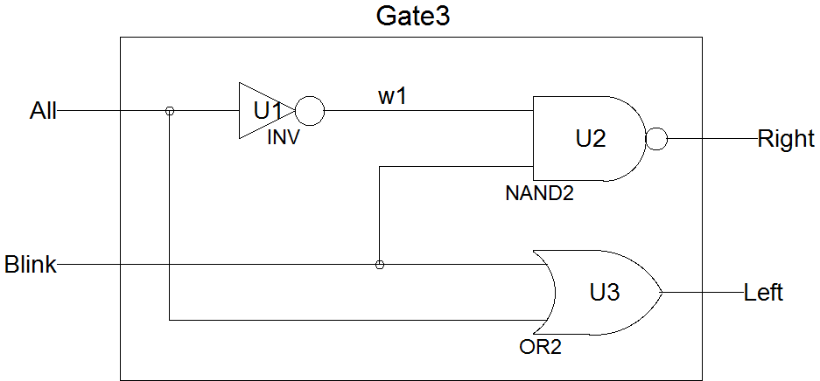
Gate3 Circuit
All | Blink | Right | Left
0 | 0 | 1 | 0
0 | 1 | 0 | 1
1 | 0 | 1 | 1
1 | 1 | 1 | 1

Slide 4
Gate Level: Verilog Module of Gate3 Circuit
Simulation Timing
`timescale 1ns / 1ps
//simulation time unit is 1ns and resolution is 1ps
//Author: Jianjian Song
//Date: August 6, 2021
//Purpose: example circuit
module Gate3Gates (All, Blink, Right, Left);
input All, Blink;
output Right, Left;
wire w1;
not U1 (w1, All);
nand U2(Right, w1, Blink);
or U3 (Left, All, Blink);
endmodule
Input/Out List
Input or Output
wire
Gates and connections

Slide 5
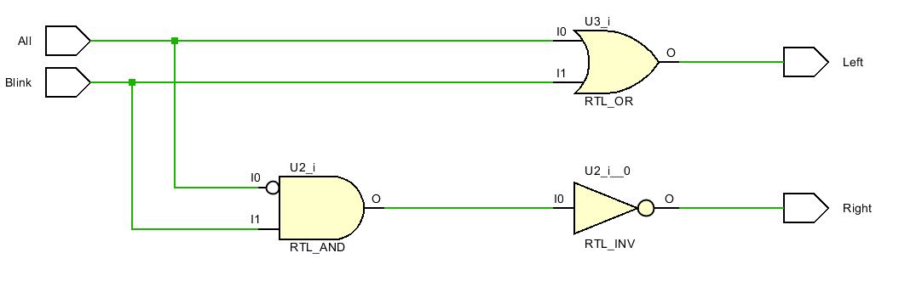
Gate3: Schematic from the Verilog Module
In Vivado, choose Open Synthesized Design under RTL Analysis to see the schematic
Notes:
All gates (except “not”) may have an arbitrary number of inputs; simply continue adding additional inputs to the list.
The “instance name” is a unique arbitrary text label placed between the primitive name and the parenthesized list of connections. While the instance name is optional for Verilog primitives, you will find that using a systematic labeling scheme (see the example on the previous page) will help minimize translation errors.
When you invoke a new primitive, you are said to be creating an “instance” of that primitive. The process of creating an instance is called “instantiation,” and you can “instantiate” as many primitives as are needed for your circuit.
The order in which primitives are instantiated makes no difference.

Slide 6








Verilog Gate Description
Logic Operator | Schematic Symbol | Verilog Component
NOT |  | not (out, in);
AND |  | and (out, in1,in2);
OR |  | or (out, in1,in2);
NAND |  | nand (out, in1,in2);
NOR |  | nor (out, in1,in2);
Exclusive-OR |  | xor (out, in1,in2);
Exclusive-NOR |  | xnor (out, in1,in2);
Buffer |  | buf(out, in)

Slide 7
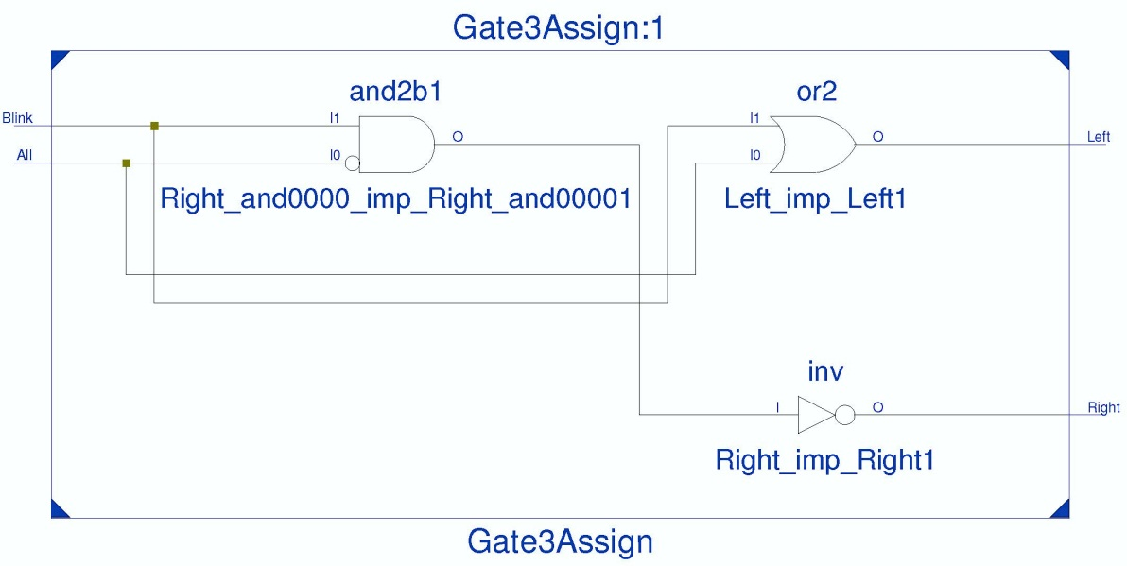
Behavior Level 1: Verilog Logic Expression with “assign”
Continuous assignments: “assign”
One output each assign
Level sensitive
Concurrent assignments
module Gate3Assign (All, Blink, Right, Left);
input All, Blink;
output Right, Left;
assign Right = !(!All&Blink);
assign Left = All | Blink;
endmodule

Slide 8
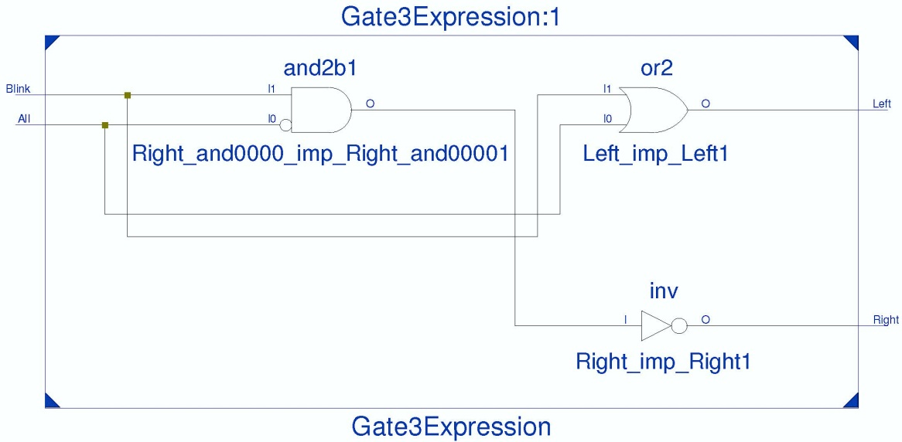
Behavior Level 2: Verilog Logic Expression with always block
Always block
More than one output
Level sensitive
Wires on the left hand side must be of type “reg” (register)
Concurrent or non-blocking <=
Sensitivity list
@( signal list )
Used by simulator to update functions
module Gate3Expression (All, Blink, Right, Left);
input All, Blink;
output reg Right, Left;
always @ (All, Blink) begin
Right <= !(!All&Blink);
Left <= All | Blink;
end
endmodule

Slide 9
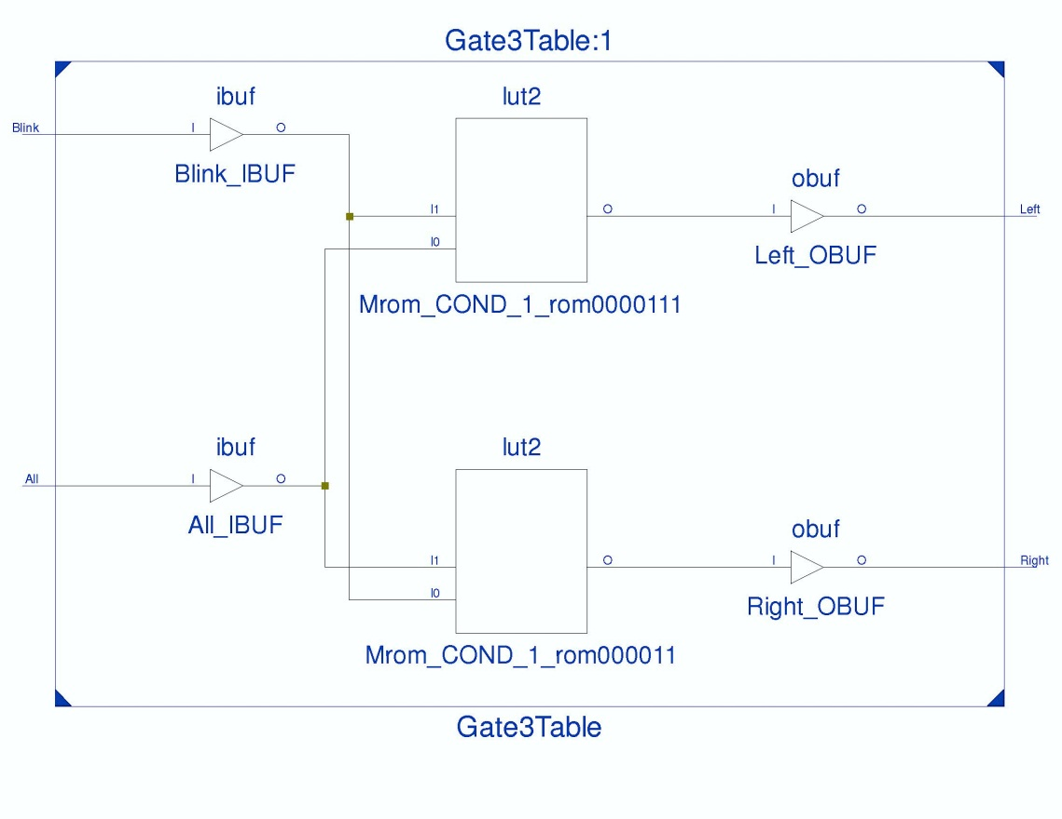
Behavior Level 3: Truth in Verilog Table for Gate3 Circuit
module Gate3Table (All, Blink, Right, Left);
input All, Blink;
output reg Right, Left;
always @(All, Blink)
case({All,Blink})
2’d0: {Right,Left}=2'b10;
2’d1: {Right,Left}=2'b01;
2’d2: {Right,Left}=2'b11;
2’d3: {Right,Left}=2'b11;
endcase
endmodule
Concatenation {x,y}
Selection case() statement
Options
value: begin content; end
Sensitivity list @( )
All | Blink | Right | Left
0 | 0 | 1 | 0
0 | 1 | 0 | 1
1 | 0 | 1 | 1
1 | 1 | 1 | 1

Slide 10
Verilog Operators
Arithmetic Operators
+ Addition
- Subtraction
* Multiplication
/ Division
% Modular
Relational Operators
<, >, <=, >=
Bit-Wise Operators
~ bit NOT
& bit AND
| bit OR
^ bit XOR
Equal Operators
==, !=
===, including X and Z values
Logic Operators
! – logic NOT
&& logic AND
|| logic OR
Shift Operators
<< shift left for #bits
>> shift right for #bits
Concatenation Operator
{ } combine wires to form a bus

Slide 11
Operators in Verilog
 | Usage | Description
Arithmetic Operators
+ | m + n | Add n to m
- | m - n | Subtract n from m
- | -m | Negate m (2's complement)
* | m * n | Multiply m by n
/ | m / n | Divide m by n
% | m % n | Modulus of m / n
Bitwise Operators
~ | ~m | Invert each bit of m
& | m & n | AND each bit of m with each bit of n
| | m | n | OR each bit of m with each bit of n
^ | m ^ n | Exclusive OR each bit of m with n
~^ ^~ | m ~^ n m ^~ n | Exclusive NOR each bit of m with n
Unary Reduction Operators
& | &m | AND all bits in m together (1-bit result)
~& | ~&m | NAND all bits in m together (1-bit result)
| | |m | OR all bits in m together (1-bit result)
~| | ~|m | NOR all bits in m together (1-bit result)
^ | ^m | Exclusive OR all bits in m (1-bit result)
~^ ^~ | ~^m ^~m | Exclusive NOR all bits in m (1-bit result)
Logical Operators
! | !m | Is m not true? (1-bit True/False result)
&& | m && n | Are both m and n true? (1-bit True/False result)
|| | m || n | Are either m or n true? (1-bit True/False result)
 | Usage | Description
Equality Operators (compares logic values of 0 and 1
== | m == n | Is m equal to n? (1-bit True/False result)
!= | m != n | Is m not equal to n? (1-bit True/False result)
Identity Operators (compares logic values of 0, 1, X and Z
=== | m === n | Is m identical to n? (1-bit True/False results)
!== | m !== n | Is m not identical to n? (1-bit True/False result)
Relational Operators
< | m < n | Is m less than n? (1-bit True/False result)
> | m > n | Is m greater than n? (1-bit True/False result)
<= | m <= n | Is m less than or equal to n? (True/False result)
>= | m >= n | Is m greater than or equal to n? (True/False result)
Logical Shift Operators
<< | m << n | Shift m left n-times
>> | m >> n | Shift m right n-times
Miscellaneous Operators
? : | sel?m:n | If sel is true, select m: else select n
{} | {m,n} | Concatenate m to n, creating larger vector
{{}} | {n{m}} | Replicate m n-times
-> | -> m | Trigger an event on an event data type

Slide 12
Operator Precedence in Verilog
Operator Precedence highest precedence
! ~ + - (unary) | Unary, sign, negate, invert
* / % | Multiply, divide, modulus
+ - (binary) | Add, subtract
<< >> | Relation
< <= > >= | Relation
== != === !== | Equality
& ~& | Bit-wise logic
| ~| | Bit-wise logic
&& | Logic AND
|| | Logic OR
?: | select
 | lowest precedence

Slide 13
Gate3: Generating Timing Waveforms
Relative time
Absolute time
Time | 1 | 2 | 3 | 4 | 5 | 6 | 7 | 8 | 9 | 10 | 11 | 12 | 13 | 14 | 15 | 16 | 17 | 18 | 19 | 20
All1
Blink1
Right2
Left2
All | Blink | Right | Left
0 | 0 | 1 | 0
0 | 1 | 0 | 1
1 | 0 | 1 | 1
1 | 1 | 1 | 1
Expected outputs

Slide 14
Gate3: Using Relative Times and Begin & End
module Gate3_TB; reg all1, blink1; wire Right2, Left2;
all1 3 4 5
blink1 3 4 5 5 3 5 3
Right2
Left2
Expected outputs

Slide 15
Verilog Test Bench - Relative Time value; #elapse time
`timescale 1ns / 1ps
module Gate3TestRelative;
reg all1, blink1; // Inputs
wire RightGates, LeftGates; // Outputs
wire RightBehavior, LeftBehavior;
wire RightTable, LeftTable;
wire RightAssign, LeftAssign;
wire NOT_output = Gate3GateChip.w1; //internal wire of a device under test (DUT)
initial begin ; #n is the number of nano seconds, which is logic time not real time.
all1 = 0; blink1 = 0; #3;
all1 = 1; blink1 = 0; #4;
all1 = 1; blink1 = 1; #5;
all1 = 0; blink1 = 1; #5;
all1 = 0; blink1 = 0; #3;
all1 = 0; blink1 = 1; #4;
all1 = 0; blink1 = 0; #3;
$stop;
end
Gate3Gates Gate3GateChip ( .Blink(blink1), .Left(LeftGates), .Right(RightGates), .All(all1));
Gate3Expression Gate3ExpressionChip (all1, blink1, RightBehavior, LeftBehavior);
Gate3Table Gate3TableChip (all1, blink1, RightTable, LeftTable);
Gate3Assign Gate3AssignChip (all1, blink1, RightAssign, LeftAssign);
endmodule
Bring out external wire
Time Relative to Previous One
Stop simulation

Slide 16
Pin Association Methods between Test Bench File and Circuit
A Test Bench File specifies the external behavior of a circuit
`timescale 1ns / 1ps – integer time unit is ns and smallest fraction is 0.001 (1ps)
Its inputs and outputs can have different names from the device under test (DUT).
input patterns and time durations for a circuit are specifies using assignments (=) and time delay units (#).
The input and output pins can be associated with a DUT in two ways:
.DUT pin(Test Bench pin) – For example, .All(all1) specifies pin All of the DUT is connected to pin all1 of the test bench.
Place the test bench pins in the same order as the pins of the DUT.
Input pins are declared reg.
Output pins are wires.
#N is the number of time units specified in `timescale when the value should hold.

Slide 17
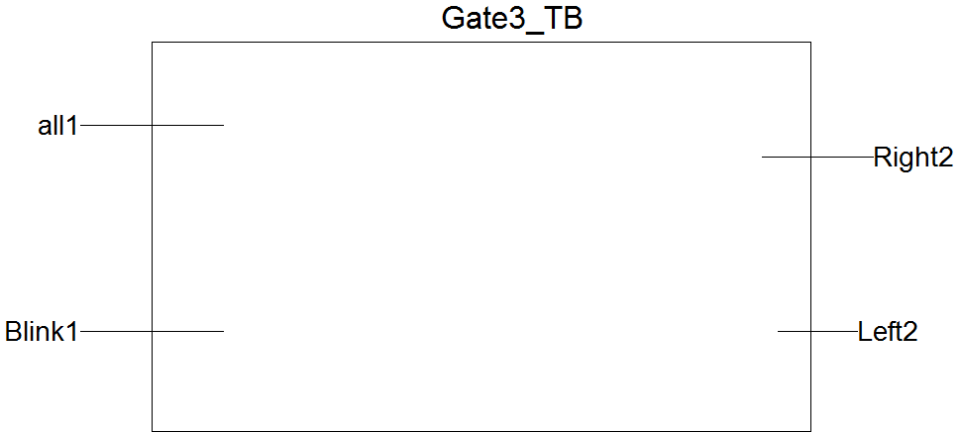
Gate3: Verilog Circuit Module and Test Bench File
Test bench specifies the external behavior of a circuit. The pins can have different names from a device under test (DUT).
Any DUT with the same external behavior can be inserted into a test bench.

Slide 18
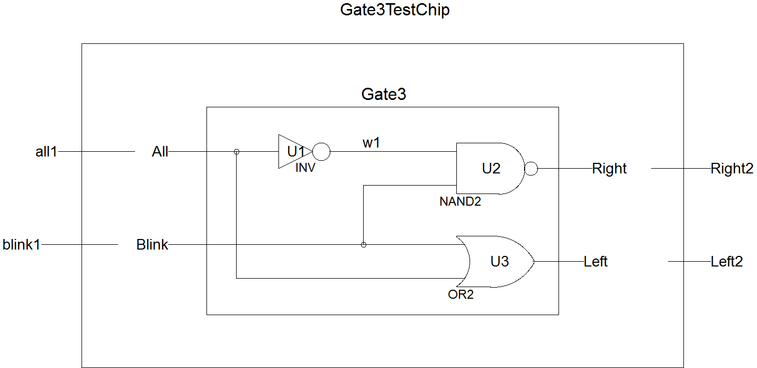
Gate3: Two Ways to Associate Test Bench and DUT
module Gate3 (All, Blink, Right, Left); //DUT = Device Under Test
module Gate3_TB; reg all1, blink1; wire Right2, Left2; //test bench
Gate3 Gate3TestChip ( .Blink(blink1), .Left(Left2), .Right(Right2), .All(all1));
Gate3 Gate3TestChip (all1, blink1, Right2, Left2);
Test wire
Circuit wire
.Blink(blink1)
Association by positions

Slide 19
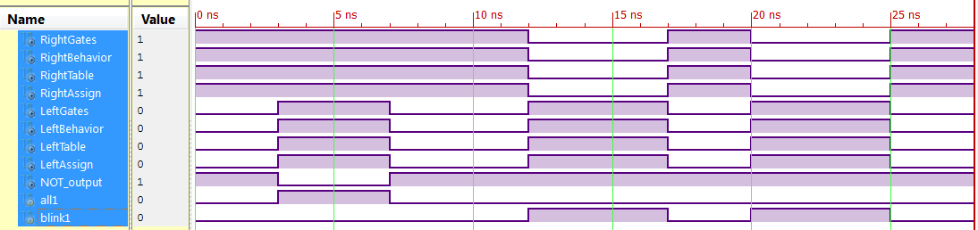
Gate3: Simulation Results

Slide 20
Gate3: Analyzing and Checking Off Simulation Results
All | Blink | Right | Left
0 | 0 | 1 | 0
0 | 1 | 0 | 1
1 | 0 | 1 | 1
1 | 1 | 1 | 1

Slide 21
Gate3: Using Absolute Time Instances & Fork and Join
module Gate3_TB; reg all1, blink1; wire Right2, Left2;
All1 3 7
all1 3 4 5
Blink1 3 7 12 17 20 25 28
blink1 3 4 5 5 3 5 3
Right2
Left2
Absolute time instances

Slide 22
Absolute Time: Verilog Test Bench File for Gate3.v
`timescale 1ns / 1ps
module Gate3TestAbsolute;
reg all1, blink1; // Inputs
wire RightGates, LeftGates; // Outputs
wire RightBehavior, LeftBehavior;
wire RightTable, LeftTable;
wire RightAssign, LeftAssign;
wire NOT_output = Gate3GateChip.w1; //internal wire of a device under test (DUT)
initial fork
#0 all1 = 0; #3 all1 = 1; #7 all1 = 0;
#0 blink1 = 0; #12 blink1 = 1; #17 blink1 = 0;
#20 blink1 = 1; #25 blink1 = 0;
#28 $stop;
join
Gate3Gates Gate3GateChip ( .Blink(blink1), .Left(LeftGates), .Right(RightGates), .All(all1));
Gate3Expression Gate3ExpressionChip (all1, blink1, RightBehavior, LeftBehavior);
Gate3Table Gate3TableChip (all1, blink1, RightTable, LeftTable);
Gate3Assign Gate3AssignChip (all1, blink1, RightAssign, LeftAssign);
endmodule
Time Instances
No semicolon after #time
fork and join
Stop at 28 ns

Slide 23
Wires and Busses
Wire type – conducting wires only to connect between components and as input and output ports or pins
input reset, mode; //a wire as primary input
output LED; //a wire as primary output
wire out1; //a conductor wire
wire [3:0] M; //4-bit wire bus
assign out1=reset | mode; //only a wire can be on the left hand side
reg type – wire type with special output properties
output wires for registers
output wires in always blocks
can be used as wires between always blocks.
cannot be used as primary input wires

Slide 24
Activity List after always @(activity list)
Add all relevant signals to the activity list to activate changes on them
Here is a up/down counter with or without input Counter in the activity list
Would the simulation waveforms for these two cases be different?
If in doubt, add all input wires to the activity list
always @ (Counter or UP)
case ({UP})
1: begin if (Counter==EndCount)
begin NextQ <= 0; end else
begin NextQ <= Counter+1; end
end
0: begin if (Counter==BeginCount)
begin NextQ <= EndCount; end else
begin NextQ <= Counter-1; end
end
endcase
always @ (UP)
case ({UP})
1: begin if (Counter==EndCount)
begin NextQ <= 0; end else
begin NextQ <= Counter+1; end
end
0: begin if (Counter==BeginCount)
begin NextQ <= EndCount; end else
begin NextQ <= Counter-1; end
end
endcase

Slide 25
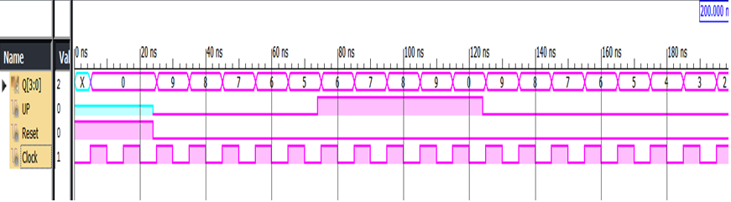
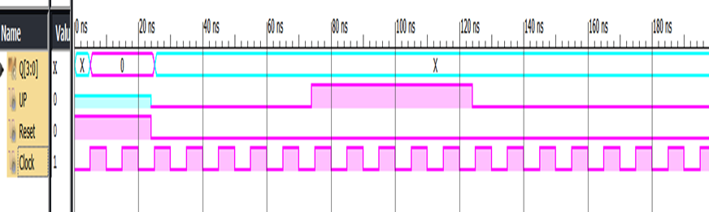

Slide 26
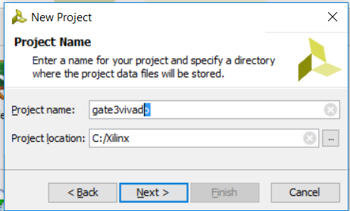
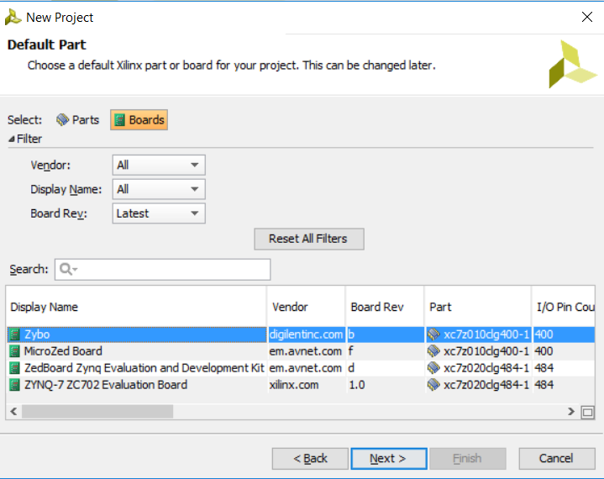
Gate3 Project with Vivado and Zybo
Open Vivado and create an RTL new project called gate3vivado
Skip all file options
Choose boards->zybo
Click finish

Slide 27


Gate3 Project with Vivado and Zybo
Create a design source file gate3gates.v
Copy gate3gates.v to this file
Create a simulation source file
Copy Gate3TestRelative to this file

Slide 28
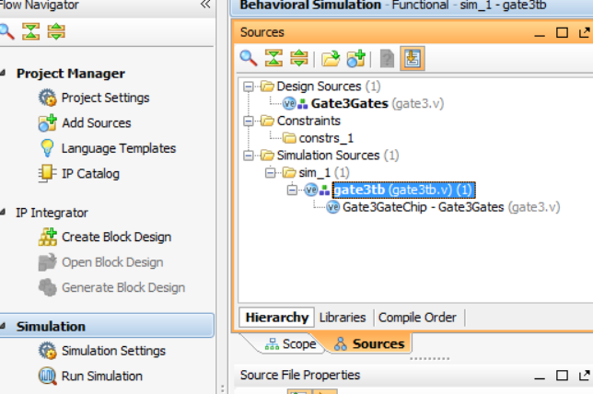
Gate3 Simulation with Vivado
Select gate3tb under sources
Choose Run Simulation->Run Behavior Simulation
Waveforms will be displayed in an Untiled window

Slide 29
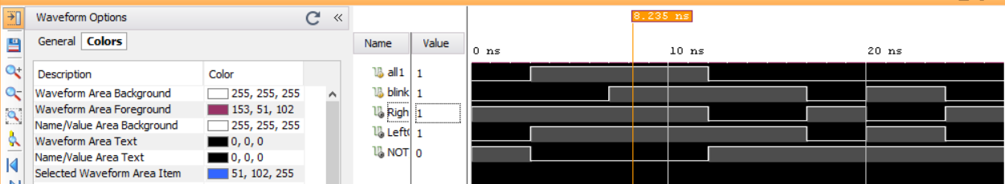
Gate3 Simulation Waveforms on Untitled Window
Click on the Waveform Options on the upper left corner to change colors
All | Blink | Right | Left
0 | 0 | 1 | 0
0 | 1 | 0 | 1
1 | 0 | 1 | 1
1 | 1 | 1 | 1

Slide 30
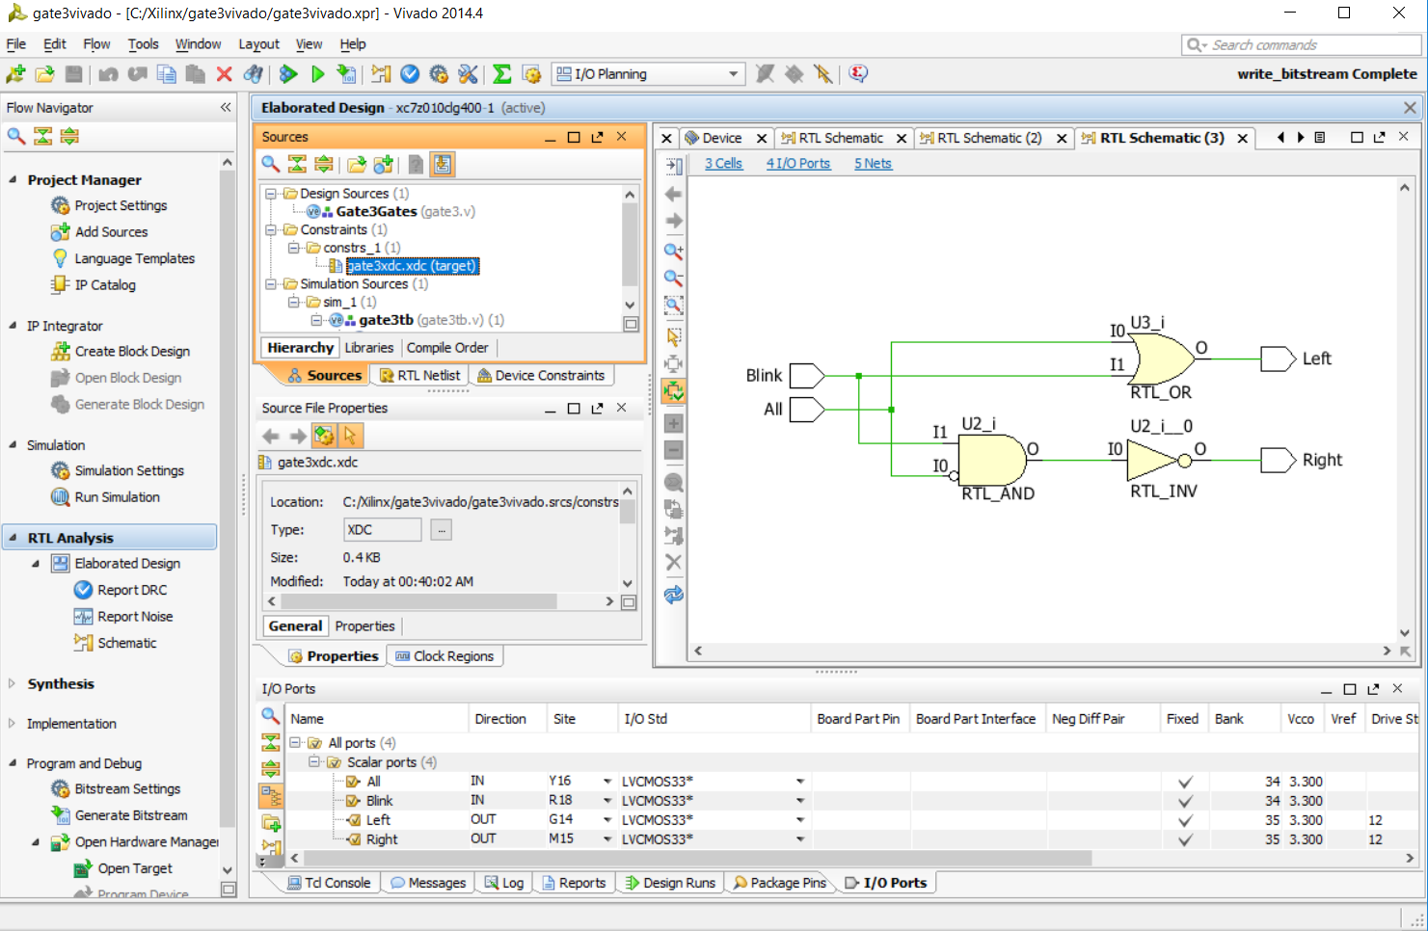

Slide 31

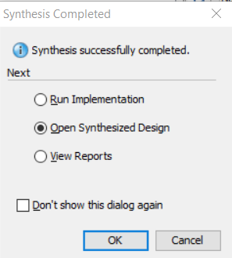
Gate3 User Constraint File XDC on Vivado and Zybo
Click on Add Sources and Add or create constraints to make an XDC file, called gate3xdc.
Run Synthesis
Choose Open Synthesized Design
Click Layout->I/O Planning to see I/O Ports

Slide 32
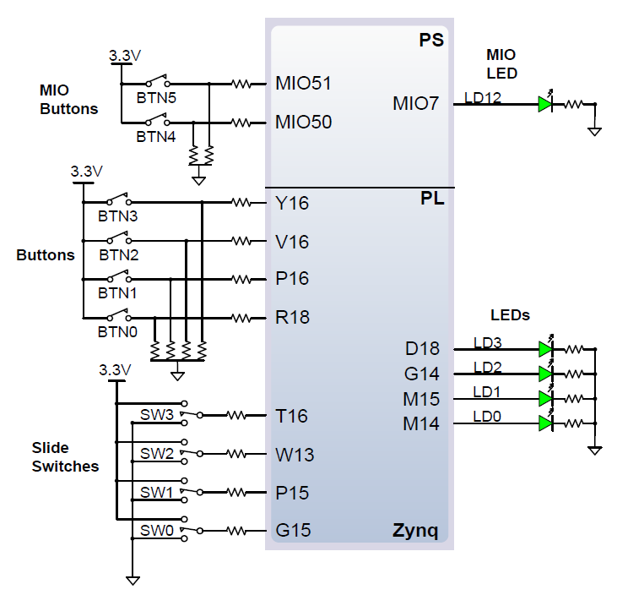
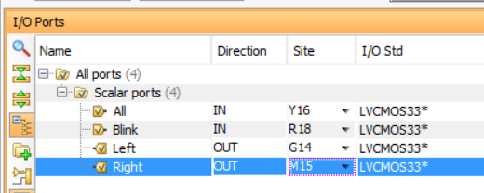
Gate3 Pin Assignment on Zybo
All = BTN3 on Y16
Blink = BTN0 on R18
Left = LD2 on G14
Right = LD1 on M15
Save constraints to gate3pins.xdc file
Run Implementation and
Then Generate Bitstream

Slide 33
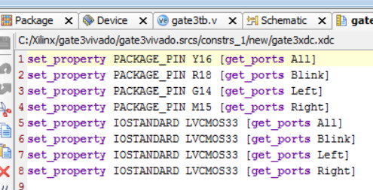
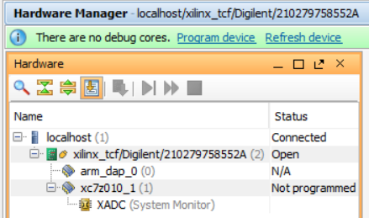
Gate3 I/O Ports and XDC File and Run gate3 on Zybo
How to run Verilog circuit on PL only
Open Hardware Manager
Click Open Target->Auto Connect
Clock Program device to download bit stream file to Zybo

Slide 34
IEEE 1364-1995, 2001, 2005
IEEE STANDARD 1364-1995 - IEEE Standard Hardware Description Language Based on the Verilog(R) Hardware Description Language
IEEE STANDARD 1364-2001 – Verilog-2001, is the first major update to the Verilog language since its inception in 1984.
Notes:
Description: The Verilog Hardware Description Language (HDL) is defined. Verilog HDL is a formal notation intended for use in all phases of the creation of electronic systems. Because it is both machine readable and human readable, it supports the development, verification, synthesis, and testing of hardware designs; the communication of hardware design data; and the maintenance, modification, and procurement of hardware. The primary audiences for this standard are the implementors of tools supporting the language and advanced users of the language.
1364-2001 - IEEE Standard Verilog Hardware Description Language IEEE STANDARD. The IEEE 1364-2001 standard, nicknamed `Verilog-2001', is the first major update to the Verilog language since its inception in 1984. The examples in this edition have been updated to illustrate the features of the language. IEEE standard Verilog hardware description language - IEEE Std. IEEE Std 1364-2001 (Revision of IEEE Std 1364-1995) IEEE Standards IEEE Standard Verilog Â® Hardware Description Language Published by The Institute of Electrical.

Slide 35
I/O Specification Differences btw IEEE 1364-1995 and 2001
IEEE 1364-1995
IEEE 1364-2001
module Gate3Assign1995 (All, Blink, Right, Left);
input All, Blink;
output Right, Left;
assign Right = !(!All&Blink);
assign Left = All | Blink;
endmodule
module Gate3Assign2005 (output Right, Left, input All, Blink);
assign Right = !(!All&Blink);
assign Left = All | Blink;
endmodule

Slide 36
Blocking (=) and Non-blocking (<=) Assignments
Blocking Assignment (=)
The statements are evaluated one after another.
Non-blocking assignment (<=)
The statements are evaluated simultaneously or concurrently.
Blocking assignments may create strange and unexpected circuits.
DO NOT use blocking assignments (=) to create circuits.
Blocking assignments may be useful to create test benches

Slide 37
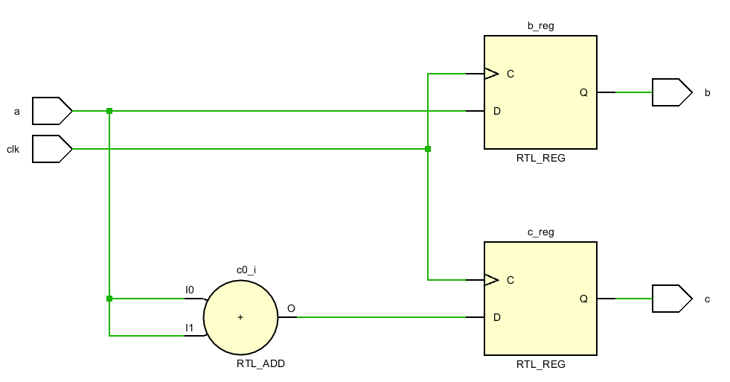
A Blocking (=) Example – a strange circuit
module blocking (clk,a, b, c);
input clk, a;
output reg b, c;
always @ (posedge clk ) begin
b = a;
c = b+a;
end
endmodule

Slide 38
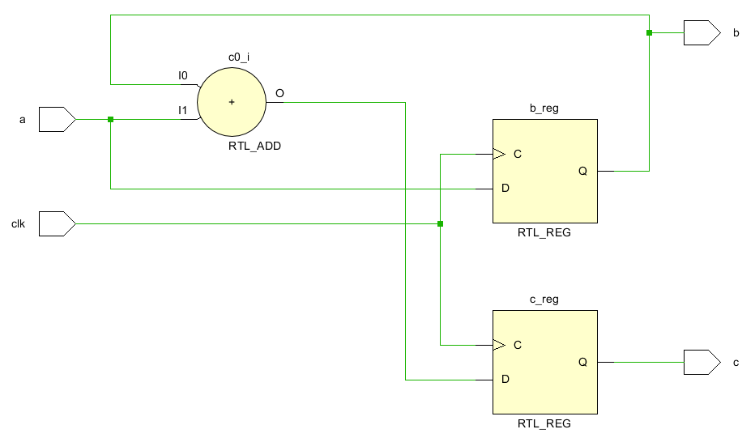
A Non-Blocking (<=) Example – an expected circuit
module non_blocking (clk,a, b, c);
input clk, a;
output reg b, c;
always @ (posedge clk ) begin
b <= a;
c <= b+a;
end
endmodule

Slide 39
Detector of Sequence 011
Create a state diagram for a sequence detector that will output a logic 1 on Z each time it receives 011 consecutively from an input X, with 1 being the latest bit received. Otherwise, the output will be logic 0. Here is a correct behavior sequence that can be used to check your solution.
Clock Cycle | 0 | 1 | 2 | 3 | 4 | 5 | 6 | 7 | 8 | 9 | 10 | 11 | 12 | 13 | 14 | 15 | 16
X | 0 | 0 | 1 | 1 | 1 | 0 | 0 | 1 | 0 | 1 | 1 | 0 | 0 | 1 | 1 | 1 | 0
Z | 0 | 0 | 0 | 1 | 0 | 0 | 0 | 0 | 0 | 0 | 1 | 0 | 0 | 0 | 1 | 0 | 0

Slide 40
Detector of Sequence for Sum of Two Inputs X and Y
Draw a state diagram to represent a circuit that has two inputs X and Y and one output Z. The output should be 1 if the sum of the number of 1s on X and Y is a multiple of 4 since initialization. Z is 0 otherwise. Use lowercase letters a, b, c, d, e, etc. to represent states. Here is an example.
Clock Cycle | 0 | 1 | 2 | 3 | 4 | 5 | 6 | 7 | 8 | 9 | 10 | 11 | 12 | 13 | 14 | 15 | 16
X | 0 | 0 | 1 | 1 | 1 | 0 | 0 | 1 | 0 | 1 | 1 | 0 | 0 | 1 | 1 | 1 | 0
Y | 0 | 1 | 0 | 0 | 1 | 1 | 1 | 0 | 0 | 0 | 1 | 1 | 0 | 0 | 0 | 1 | 0
Z | 1 | 0 | 0 | 0 | 0 | 0 | 0 | 1 | 1 | 0 | 0 | 1 | 1 | 0 | 0 | 1 | 1

Slide 41
XY=01, 10
XY=00
XY=00
B=1/z=0
A=0/z=1
11
11
01,10
01,10
11
11
C=2/z=0
D=3/z=0
01,10
XY=00
00

Slide 42
Another State Diagram: A Vending Machine Controller
Draw a state diagram of a vending machine that will dispense a can of drink for 30¢. The machine will take nickel, dime, and quarter but will not give change. Use letters a, b, c, d, etc. to represent states. Assume that only one coin is present at a time at the inputs.

Slide 43
5¢ /z=0
X=5¢
X= 0¢
X=5¢
10¢ /z=0
0¢ /z=0
X=10¢
25¢
X=5¢
10¢
X=25¢
15¢ /z=0
30¢ /z=1
25¢ /z=0
20¢ /z=0
X=5¢
X=5¢
X=5¢

Slide 44
Detector of Sequence 011: State Diagram and State Assignment

Slide 45
Characteristic Equations of Flip-flops

Slide 46
Flip-flop transition tables

Slide 47
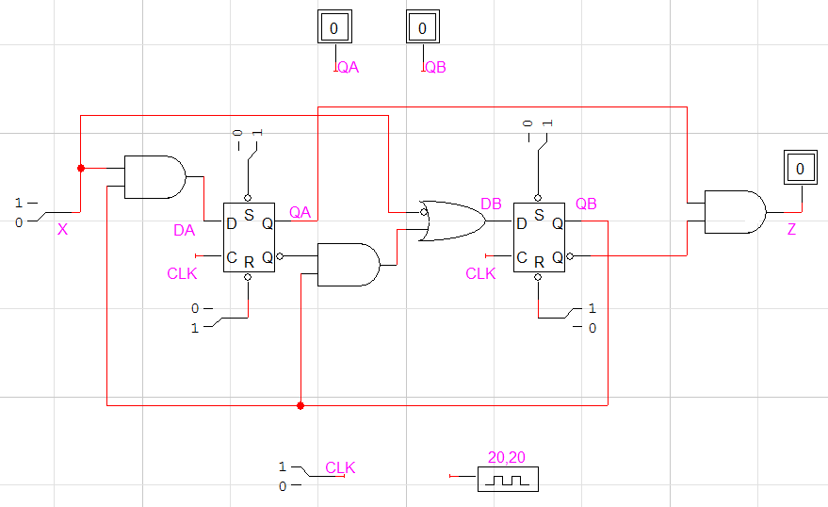
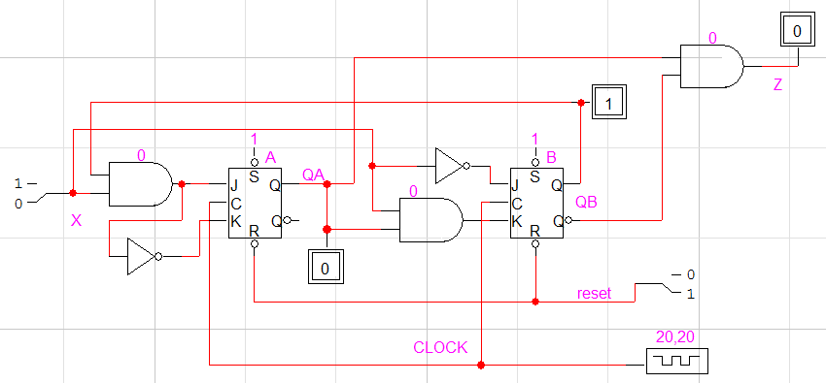
Detector of Sequence 011: Designs with D or JK Flip-flops
LogicWorks 5 Demonstration

Slide 48
Detector of Sequence 011: Logic Expressions
`timescale 1ns / 100ps
// File name : detect011withExpressions.v
// If the input X is 011 with 0 being the first bit, the output Z will produce a "1"
//the detection is recursive.
module detect011Expressions(input X, reset, CLOCK, output Z);
reg QA, QB;
wire DA,DB;
// D flip-flops
always @ (posedge CLOCK)
if (reset==1) begin QA<=0; QB<=0; end
else begin QA<=DA; QB<=DB; end
assign Z=QA&~QB;
assign DA= X&QB;
assign DB=~X | ~QA&QB;
endmodule

Slide 49
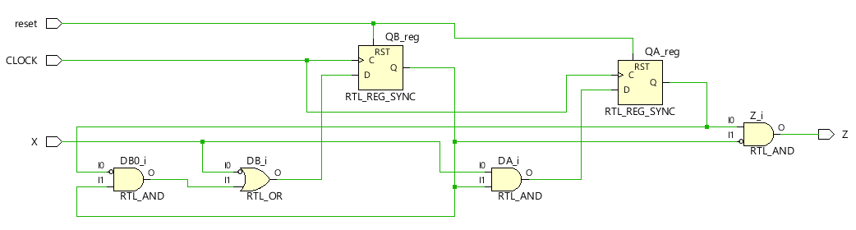
Detector of Sequence 011:Gates and Flip-flops with Vivado

Slide 50
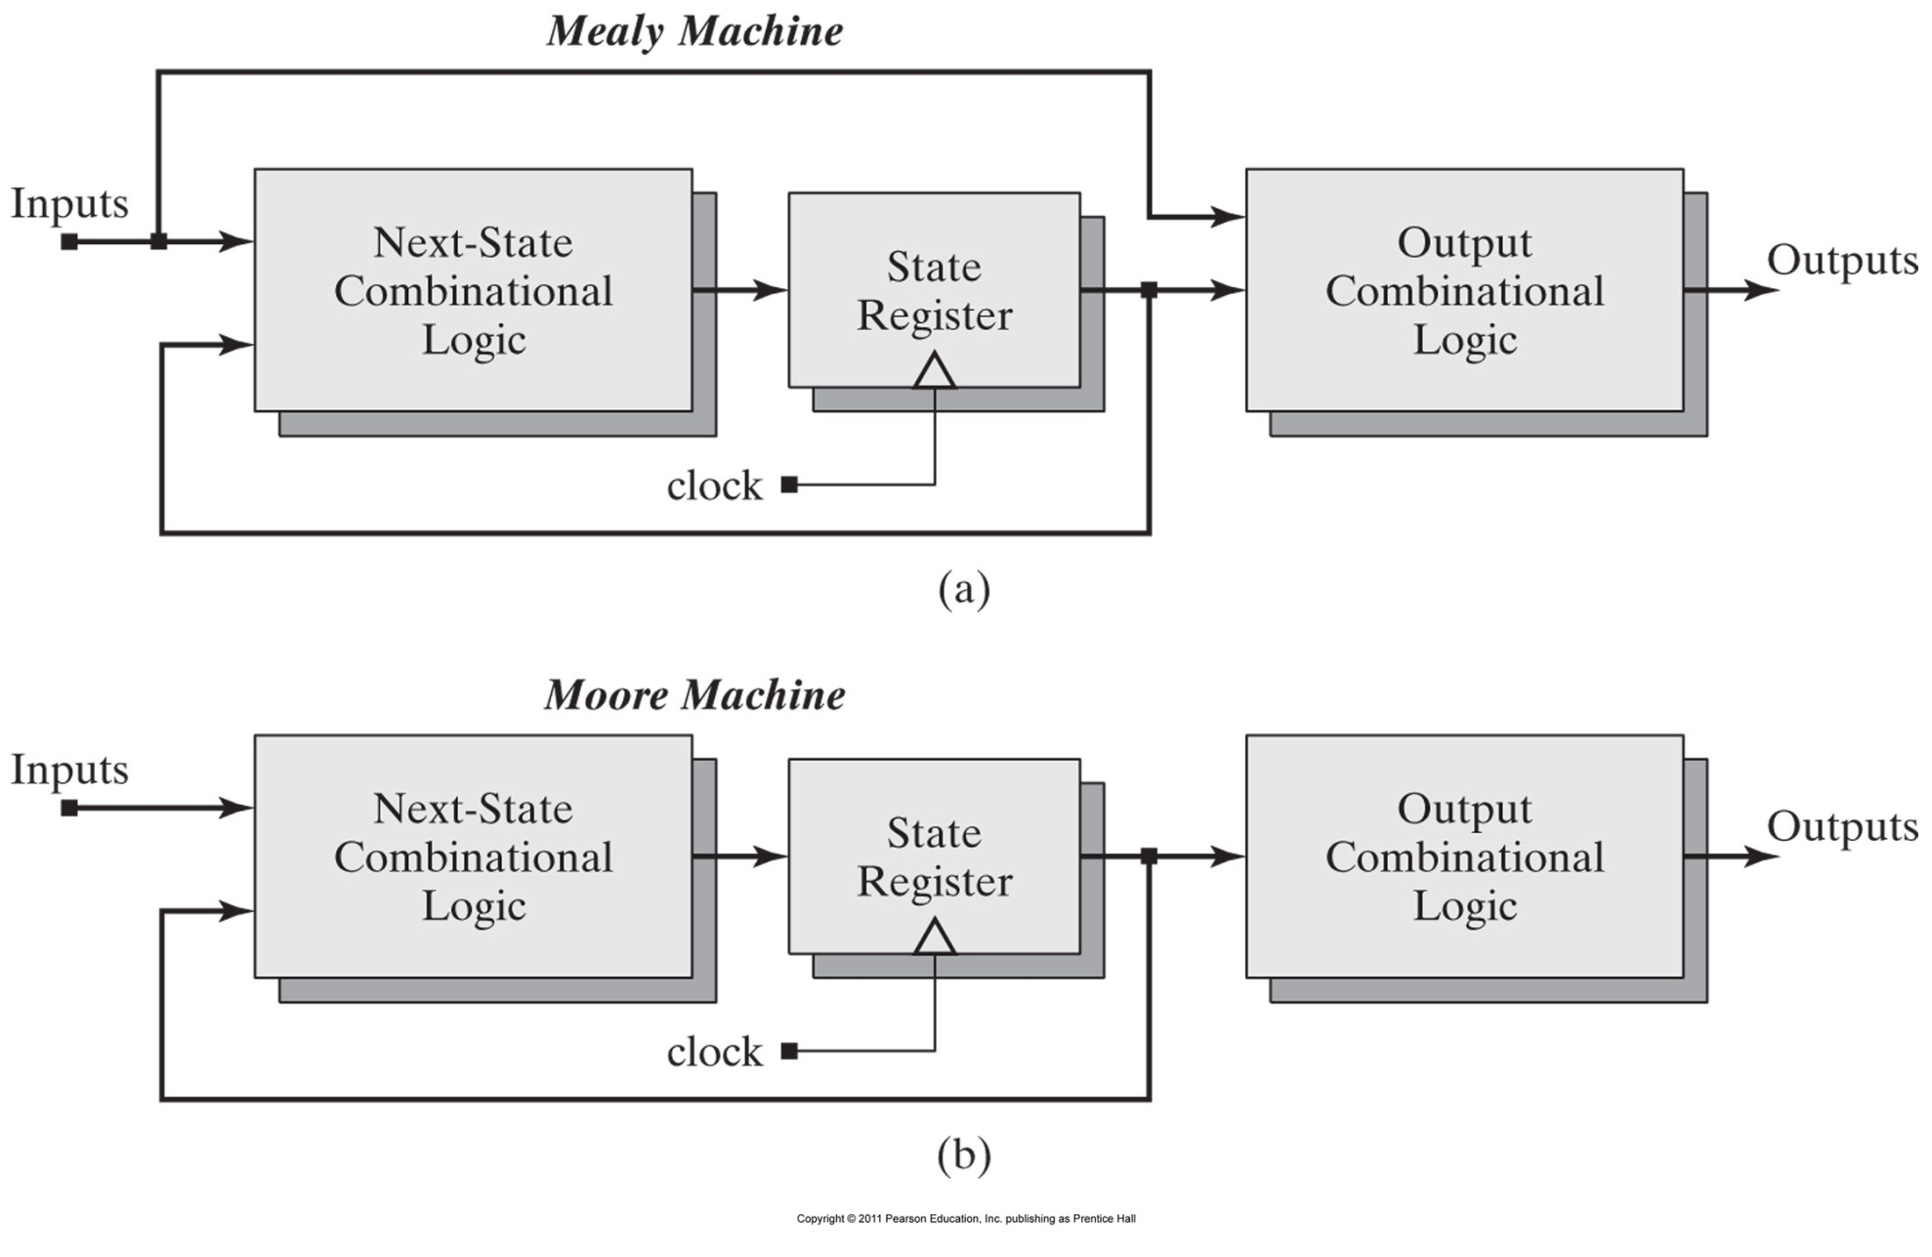
Finite state machines: (a) a Mealy machine and (b) a Moore machine.

Slide 51
Detector of Sequence 011: Verilog Sate Machine, Version 1
`timescale 1ns / 100ps
// File name : detect011StateMachineV1.v
// If the input X is 011 with 0 being the first bit, the output Z will produce a "1"
//the detection is recursive.
module detect011StateMachineV1(input X, RESET, CLOCK, output reg Z,
// State variables
output reg [1:0] CurrentState);
reg [1:0] NextState;
// State codes
parameter State1 = 2'b00, State0 = 2'b01, State011 = 2'b10, State01 = 2'b11;
// Output logic
always @ (CurrentState)
if (CurrentState == State011) Z <= 1;
else Z <= 0;

Slide 52
Detector of Sequence 011 Version 1: Verilog Sate Machine
// State registers
always @ (posedge CLOCK)
begin
if (RESET==1) CurrentState <= State1;
else CurrentState <= NextState;
end
//next state logic
always@(CurrentState or X)
case (CurrentState)
State1: if (X==0) NextState <= State0; else NextState <= State1;
State0: if (X==0) NextState <= State0; else NextState <= State01;
State011: if (X==0) NextState <= State0; else NextState <= State1;
State01: if (X==0) NextState <= State0; else NextState <= State011;
default: NextState <= State1;
endcase
endmodule

Slide 53
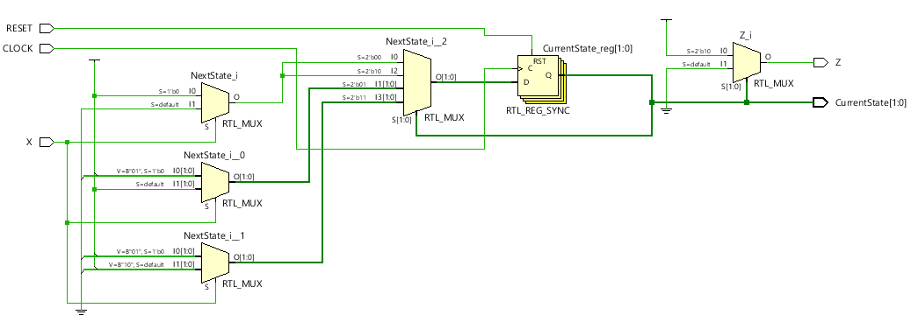
Detector of Sequence 011 Version 1: RTL Circuit with Vivado

Slide 54
Detector of Sequence 011 Version 2: Verilog Sate Machine
// File name : detect011StateMachineV2.v
// If the input X is 011 with 0 being the first bit, the output Z will produce a "1"
// The detection is recursive.
module detect011StateMachineV2(input X, RESET, CLOCK, output reg Z,
// State variables
output reg [1:0] CurrentState);
// State codes
parameter State1 = 2'b00, State0 = 2'b01, State011 = 2'b10, State01 = 2'b11;
// Output logic
always @ (CurrentState)
if (CurrentState == State011) Z <= 1;
else Z <= 0;
// State registers
always @ (posedge CLOCK)
if (RESET==1) CurrentState <= State1; else
case (CurrentState)
State1: if (X==0) CurrentState <= State0; else CurrentState <= State1;
State0: if (X==0) CurrentState <= State0; else CurrentState <= State01;
State011: if (X==0) CurrentState <= State0; else CurrentState <= State1;
State01: if (X==0) CurrentState <= State0; else CurrentState <= State011;
default: CurrentState<=State0;
endcase
endmodule

Slide 55
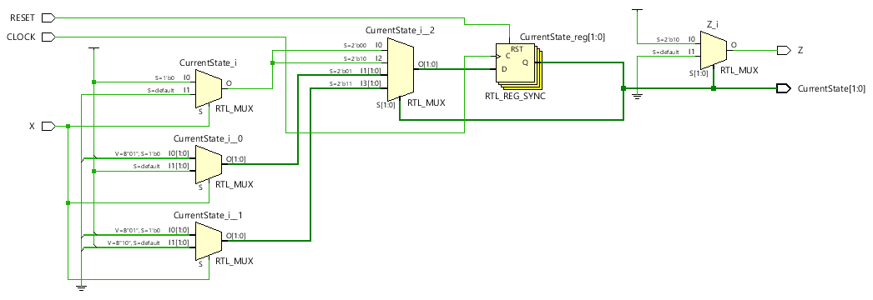
Detector of Sequence 011 Version 2: Schematic with Vivado

Slide 56
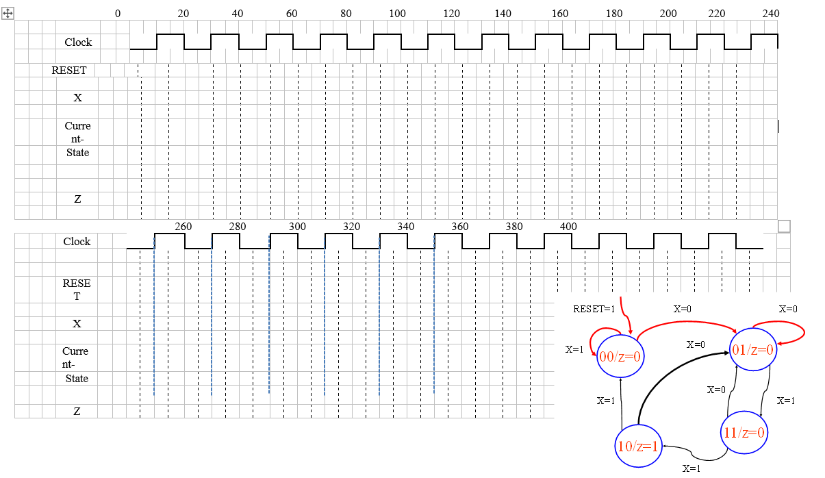
Detector of Sequence 011: Test Pattern Generation

Slide 57
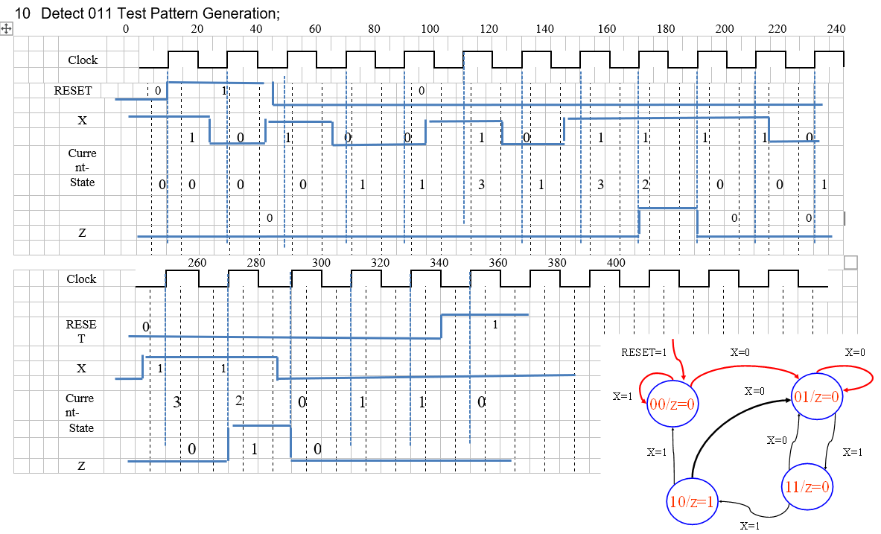
Detector of Sequence 011: Test Pattern Generation

Slide 58
Detector of Sequence 011: Test Fixture
`timescale 1ns / 100ps
// File name : detect011TB.v
// If the input X is 011 with 0 being the first bit, the output Z will produce a "1". The detection is recursive.
module detect011_test_circuit;
reg X, R, clk;
wire Zstate, Zexp, Zversion2;
wire [1:0] CurrentState,StateV2;
wire [1:0] Nextstate= UnitV1.NextState;
wire [1:0] StateExp= {UnitExpressions.QA,UnitExpressions.QB};
initial begin #0 clk=0; end //initial value for input clock
always #10 clk=~clk; //generate a periodic signal as clock
initial fork //absolute time instances
#0 R=0; #15 R = 1; #43 R=0; #340 R=1;
#0 X=1; #22 X=0; #42 X=1; #67 X=0;
#103 X=1; #121 X=0; #143 X=1;
#215 X=0; #242 X=1; #284 X=0;
#380 $stop;
join
detect011StateMachineV1 UnitV1(X, R, clk, Zstate, CurrentState);
detect011Expressions UnitExpressions(X, R, clk, Zexp);
detect011StateMachineV2 UnitV2(X, R, clk, Zversion2, StateV2);
endmodule

Slide 59
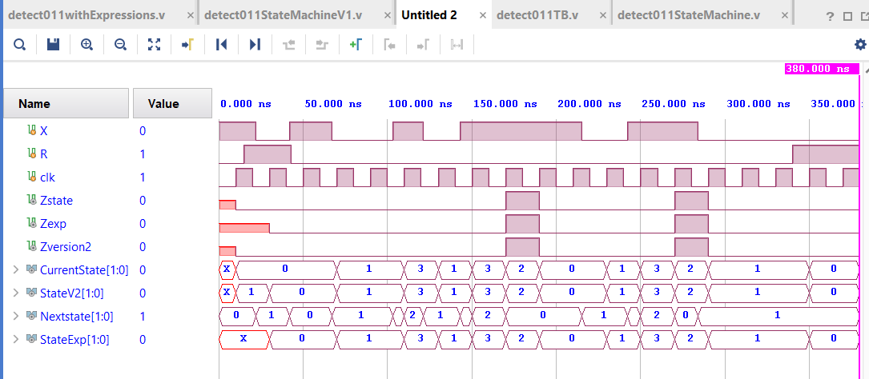
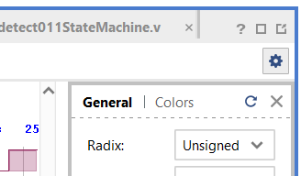
Detector of Sequence 011: Simulation Waveform
How to change default radix to unsigned decimal

